Slide 1
RESEARCH AND SIMULATION OF TSCH FOR WIRELESS SENSOR NETWORK
Author: Cung The Hung
Class: LTU11B
Supervisor: Msc. Banh Thi Quynh Mai

Slide 2
RESEARCH AND SIMULATION OF TSCH FOR WIRELESS SENSOR NETWORK
1.
3.
INTRODUCTION
DEPLOY AND RESULTS
2.
4.
THEORY AND TECHNOLOGY
CONCLUSTION

Slide 3
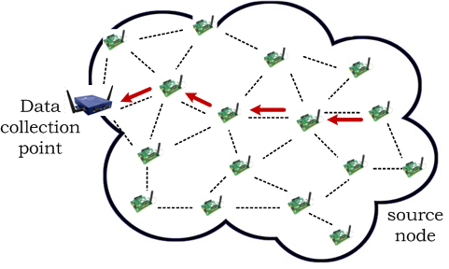
WSN is a network of autonomous sensor nodes
to monitor environmental conditions
to communicate through wireless medium
to cooperatively relay data to a collection point
Notes:
Then, what is WSN? It is a ….
Like in monitoring applications
The data collection point is called sink
The sensor node sensing the environment is called source node

Slide 4
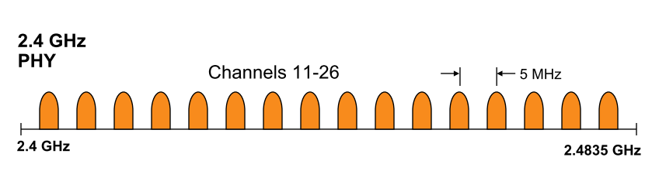
IEEE 802.15.4 – Low rate wireless personal area network
Source: Eaton
Notes:
2.4 GHz un-licensed spectrum band
ISM band: Un-licensed band for Industrial, Scientific and Medical application
According to 802.15.5 standard, sensor nodes can operate on 16 different channels on 2.4GHz band.
However, this band is rather crowded, with the presense of Wifi devices, Bluetooth devices,
Also micro-wave devices.

Slide 5
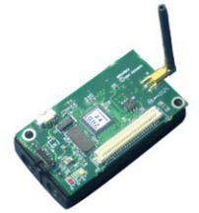
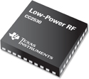
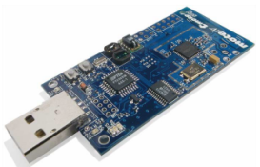
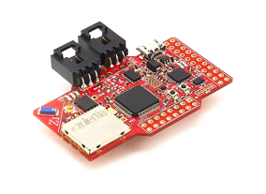
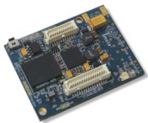
Sensor node is resource-constrained
Low memory
Low processing
capability
Low bandwidth
Low power
~10KB RAM
~100KB ROM
(4 or 8 or 16 MHz)
(max 250 Kbps)
2-3 AA batteries

Slide 6
“How to provide energy-efficient and reliable delivery of a large amount of data in WSNs that have limited resources?”
Notes:
Hence, the current demand of those above mentioned WSN applications would require a large amount of data delivery
The research question in my study will be

Slide 7
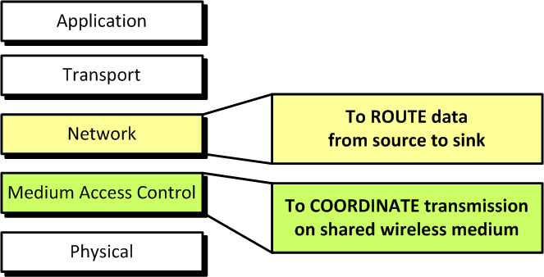
Communication is energy-greedy
Notes:
Communication is considered as the major contribution in energy consumption of a sensor node.
In comm protocol stack we studies on two layer.
The function of network layer, or called routing layer, is to find the efficient route to deliver data from source to sink
Second, we focus on the MAC layer because the MAC layer will decide what really have been transmitted on air and control the operation of the radio transceiver to be ON or OFF to save the energy.

Slide 8
RESEARCH AND SIMULATION OF TSCH FOR WIRELESS SENSOR NETWORK
1.
3.
INTRODUCTION
DEPLOY AND RESULTS
2.
4.
THEORY AND TECHNOLOGY
CONCLUSTION

Slide 9
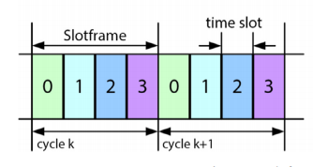
TIME SLOTTED CHANNEL HOPPING (TSCH)
TSCH is used by Low-Power devices to communicate using a wireless link. It is designed for low-power and lossy networks (LLNs) and aims at providing a reliable Media access control layer.
Slotframe structure and synchronization
In the TSCH, mode nodes synchronize on a periodic slotframe consisting of a number of timeslots:
Slotframe (TSCH)

Slide 10
TIME SLOTTED CHANNEL HOPPING (TSCH)
Then, the frequency f to be used for communication in timeslot n of the slotframe is derived as follows.
f = F[(ASN + channelOffset) % N_channels]
where ASN is the Absolute Slot Number, defined as the total number of timeslots elapsed since the start of the network. The ASN increments globally in the network, at every timeslot, and is thus used by nodes as timeslot counter. Function F can be implemented as a lookup table.

Slide 11
TSCH
TSCH: TimeSlotted (Synchronized)
Time is divided into time slots
In every slot, three possible actions: transmission, reception and sleep
Slots can be shared or dedicated
All motes are synchronized to a given slotframe
Slotframe: group of time slots which repeats over time
Number of time slots per slotframe is tunable
0
1
2
…
99
0
1
2
…
99
slotframe
cycle (k + 1)
t
cycle k

Slide 12
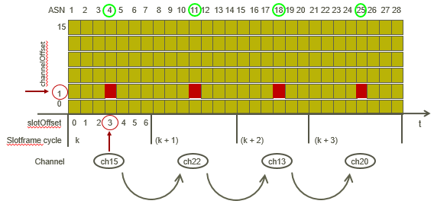
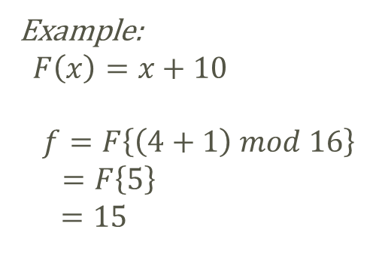


TSCH Schedule
$$f=F\left\{\left(ASN+chOF\right) mod n_{ch}\right\}$$
Example:
$F\left(x\right)=x+10$
$$f=F\left\{\left(4+1\right) mod 16\right\}$$
$=F\left\{5\right\}$
$$=15$$
$$Channel 15$$

Slide 13
TSCH
Multiples coexisting slotframes are allowed by the standard
The standard specifies how to execute the schedule but not how to build it
Synchronization information is added to ALL packets
Nodes join by listening to one channel and wait for an Enhanced Beacon from a node already in the network

Slide 14
RPL
RPL is an oriented distance-vector routing protocol that organizes nodes in a Destination Oriented Directed Acyclic Graph (DODAG) structure.
Directed acyclic graph (DAG): is a finite directed graph with no directed cycles.
Destination Oriented Directed Acyclic Graph (DODAG) is a DAG rooted at a single destination.
RPL network is flexible, with 3 capabilities
Self – configuration
Self – healing
Scaling
After the end node joins the network, paths (or routes) will be automatically formed by end nodes connected until it reaches the coordinator.
If a node in a network fails, messages are sent via other nodes.
=> Loss of one or more nodes does not necessarily affect operation of the network
RPL network can be simply expanded by adding more end nodes

Slide 15
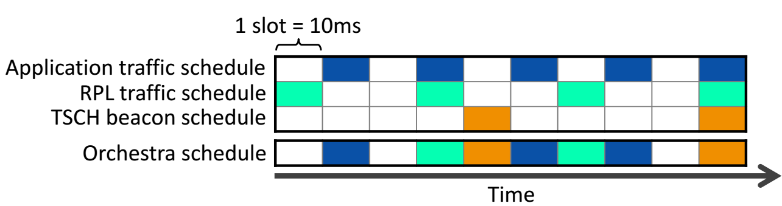
ORCHESTRA: BIG PICTURE
Autonomous distributed scheduling for TSCH+RPL networks
Multiple slotframes, each one dedicated to a particular traffic types
(e.g. TSCH beacons, RPL signaling traffic, application data)
An Orchestra schedule contains (at least):
A dedicated broadcast slot from every node to its children for TSCH beacons repeating every X slots;
A slot common for all nodes in the network for broadcast+unicast for RPL signaling (DIO, DIS, DAO), repeating every Y slots;
A dedicated unicast slot from every node to its RPL preferred parent, repeating every Z’ slots;
N dedicated unicast slots from every node to each of its children, repeating every Z" slots.
Notes:
X, Y, Z’ & Z’’ are mutually prime to avoid unintended synchronization effects.
Nodes maintain their own schedule locally and autonomously, based on their RPL neighbors and parents

Slide 16
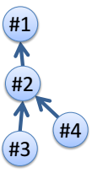
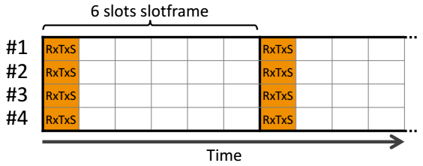
ORCHESTRA SLOTS
Common Shared Orchestra Slots (CS)
Receiver-based Shared Orchestra Slots (RBS)
Sender-based Shared Orchestra Slots (SBS)
Sender-based Dedicated Orchestra Slots (SBD)
Notes:
CS Orchestra slots consist in one shared slot used by all nodes in the network for both Rx (reception) and Tx (transmission), as illustrated in Figure 3b. The slot is installed at fixed coordinates (time and channel offset), resulting in a behavior similar to slotted ALOHA. This emulates an always-on link, allowing RPL to discover neighbors and run seamlessly. Note that TSCH uses an exponential back-off to resolve contention in shared slots, triggered whenever a unicast transmission is unacknowledged.
CS Orchestra slots consist in one shared slot used by all nodes in the network for both Rx (reception) and Tx (transmission)

Slide 17
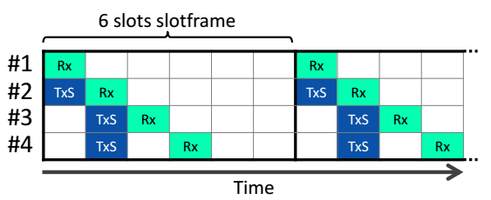
ORCHESTRA SLOTS
Common Shared Orchestra Slots (CS)
Receiver-based Shared Orchestra Slots (RBS)
Sender-based Shared Orchestra Slots (SBS)
Sender-based Dedicated Orchestra Slots (SBD)
Notes:
RBS are assigned for communication between two neighbors, at coordinates (time and channel offset) derived from properties of the receiver. At every node, a RBS Orchestra slot results in one Rx slot (coordinates based on the node), and one Tx slot per neighbor (coordinates based on the neighbor). To calculate slot coordinates, one can use a hash of the node’s MAC address, modulo the slotframe length, or exploit unique node identifiers when available. A typical example is for child-to-parent communication: nodes listen for any traffic in one slot, and children maintain a transmit slot towards their parent. As nodes switch parent, they update their transmit slot autonomously. Because several nodes may install slots towards the same receiver, contention may arise in such slots. For instance in Figure 3c, #3 and #4 contend to send to their parent #2, using standard TSCH back-off At every node, a RBS Orchestra slot results in one Rx slot (coordinates based on the node), and one Tx slot per neighbor (coordinates based on the neighbor)

Slide 18
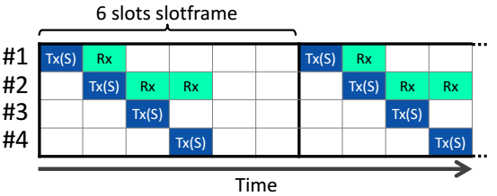
ORCHESTRA SLOTS
Common Shared Orchestra Slots (CS)
Receiver-based Shared Orchestra Slots (RBS)
Sender-based Shared Orchestra Slots (SBS)
Sender-based Dedicated Orchestra Slots (SBD)
Notes:
SBS are similar to RBS, except that the slot coordinates are obtained from properties of the sender node rather than the receiver. At every node, a SBS Orchestra slot results in one Rx slot per neighbor (coordinates based on the neighbor) and a single Tx slot (coordinates based on sender node).
This results in higher energy consumption than RBS (Tx slots cost nothing when there is no traffic, whereas Rx slots always require a wakeup), but can also help decrease contention by avoiding per-receiver slot assignement.
For child-to-parent communication, nodes have one fixed Tx slot, and parents maintain a Rx slot for each of their children.
Whenever switching parent, the child does not need to update its transmit slot, but the old parent must remove a listen slot and the new parent install a new one. SBS are similar to RBS, except that the slot coordinates are obtained from properties of the sender node rather than the receiver. At every node, a SBS Orchestra slot results in one Rx slot per neighbor (coordinates based on the neighbor) and a single Tx slot (coordinates based on sender node)

Slide 19
ORCHESTRA SLOTS
Common Shared Orchestra Slots (CS)
Receiver-based Shared Orchestra Slots (RBS)
Sender-based Shared Orchestra Slots (SBS)
Sender-based Dedicated Orchestra Slots (SBD)
Notes:
In a slotframe long enough to accommodate unique transmit slots to every node, and assuming unique node identifiers are available, contention-free communication is possible. Orchestra achieves contention-free communication with SBD, which are similar to SBS except they use dedicated TSCH slots instead of shared

Slide 20
ORCHESTRA SLOTFRAME
The length of a slotframe introduces a trade-off in traffic capacity, network latency and energy consumption.
Traffic Capacity
Shorter slotframes have their slots repeat more often, resulting in higher traffic capacity
Network Latency
The per-hop latency on a given traffic plane is basically proportional to the length of the slotframe for this particular traffic plane
Energy Consumption
Similarly, the shorter the slotframe, the more often nodes have to wake up to listen or transmit, resulting in higher energy baseline

Slide 21
ORCHESTRA SCHEDULING RULES
Orchestra maintains its schedules using simple scheduling rules, described in this section.
Handle (std)
A unique positive integer for both identify and priority. The smaller it is, the higher the priority.
Length (ext)
The number of slots in the slotframe. Must be mutually prime with all other slotframe lengths in the network.
Traffic Filter (new)
The trafficplane the slotframe is intended for. Filters packet properties (e.g., unicast, broadcast) and protocols (e.g., TSCH, RPL).

Slide 22


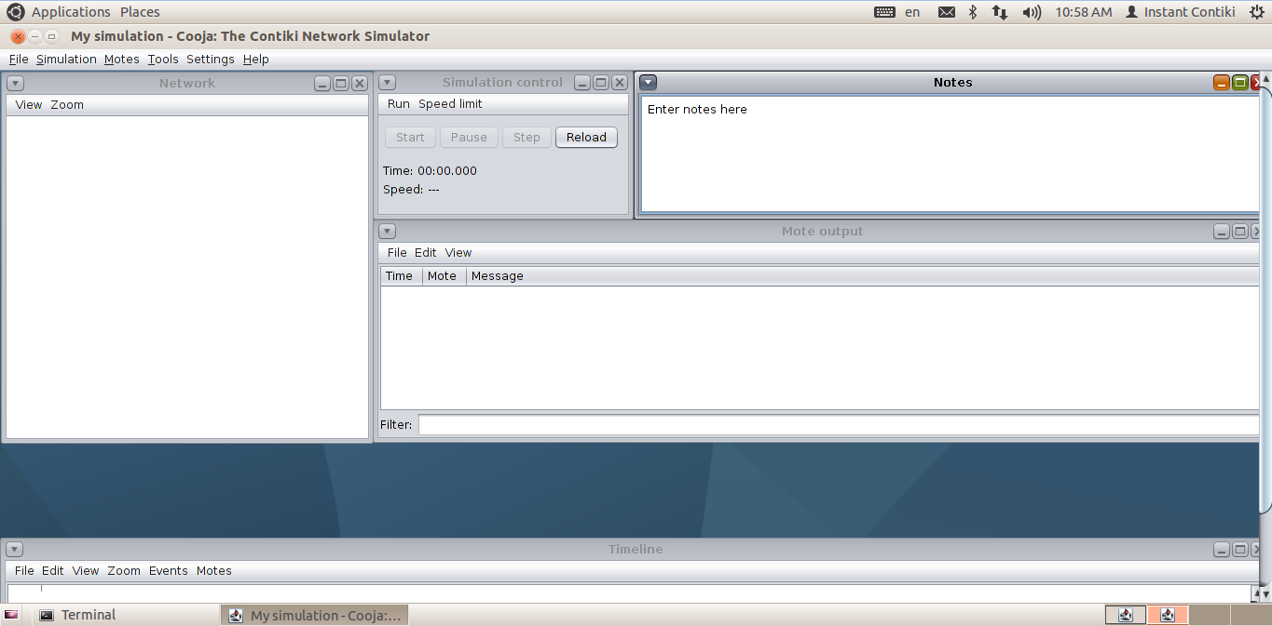
CONTIKI OPERATING SYSTEM AND SIMULATION COOJA
CONTIKI OPERATING SYSTEM.
Contiki is an open operating system designed specifically for applications with limited memory such as sensor nodes in wireless networks. Contiki is built on the C language, the open operating system with a small capacity and is based on the control of events.
COOJA-SIMULATION TOOL
COOJA (Contiki OS Java) is a simulation tool for wireless sensor network is built on the Contiki operating system, is the first program written in Java but allows for compilation and simulation of sensor nodes language C.

Slide 23
RESEARCH AND SIMULATION OF TSCH FOR WIRELESS SENSOR NETWORK
1.
3.
INTRODUCTION
DEPLOY AND RESULTS
2.
4.
THEORY AND TECHNOLOGY
CONCLUSTION

Slide 24
GOAL OF DEPLOYMENT
Deploy a network to observe change in QoS in an Orchestra-RPL-TSCH network
Approach: By changing the length of unicast slotframe
Results: Comparison of 2 levels of QoS in terms of
QoS 0: Length of slotframe of unicast is set default
QoS 1: Length of slotframe of unicast is 27
Latency is average time of sending packet from Node to Coordinator (ms)
PDR is ratio of successfully sending packet (%)
Energy Consumption is indirectly calculated through percentage of time Nodes wake in total time Nodes operate

Slide 25
GOAL OF DEPLOYMENT
Each client node has UDP packets to send over a predefined period to the coordinator (root)
Scenario:
After each 10 seconds the client nodes will send data to coordinator simultaneously.
After each 5 seconds the client nodes will send data to coordinator simultaneously.
After each 1 seconds the client nodes will send data to coordinator simultaneously.

Slide 26
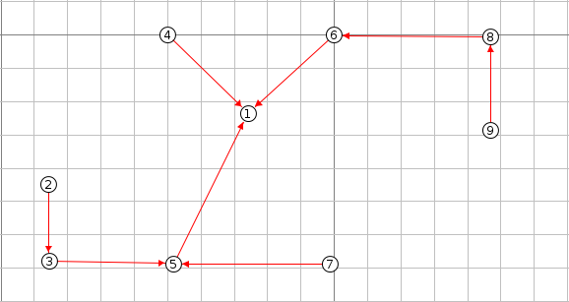
DEPLOY AND RESULTS
Network Topology
Parameters
1 coordinate node | Node 1 in the central
8 client nodes | 8 equal nodes from 2 to 9
Transmission Range | 30 m / 50 m
Network Model | TSCH-RPL-Orchestra No Loss
Network Topology

Slide 27
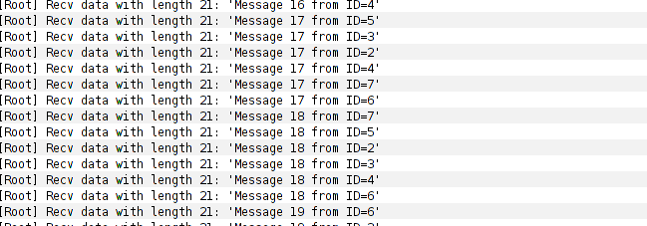
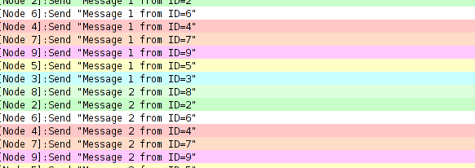
GATHERING DATA
List message receive from node
List message coordinator receive.

Slide 28
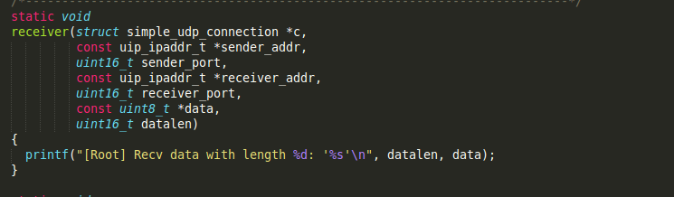
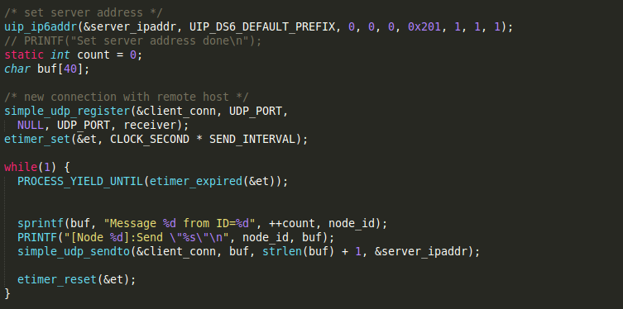
GATHERING DATA
This is snip code of coordinator and node for sending and receiving UDP packet.
Snip code for receiving UDP packet
Snip code for sending UDP packet

Slide 29
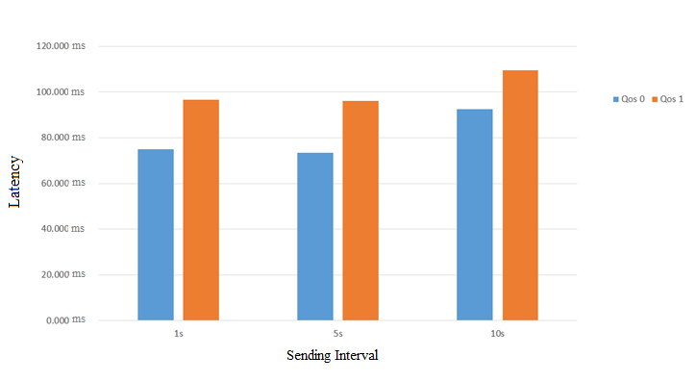
RESULTS
Chart of Latency

Slide 30
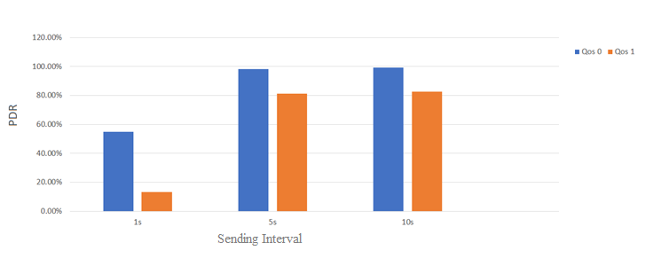
RESULTS
Chart of PDR

Slide 31
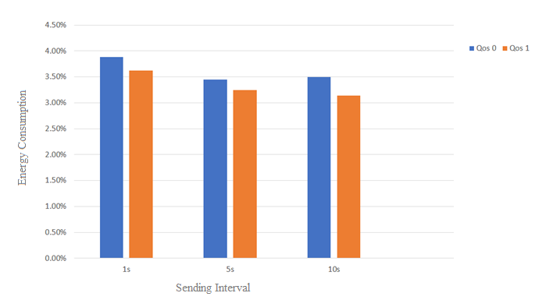
RESULTS
Chart of Energy Consumption

Slide 32
RESEARCH AND SIMULATION OF TSCH FOR WIRELESS SENSOR NETWORK
1.
3.
INTRODUCTION
DEPLOY AND RESULTS
2.
4.
THEORY AND TECHNOLOGY
CONCLUSTION

Slide 33
CONCLUSION
To sum up, networks have a crucial influence in changing the Quality of Service. We need to find suitable standards for each network
However, there are some limitations in implementation:
The new test results are only made on the simulator not put into reality.
The test has few nodes, because the broadcast control message has not yet been executed but only unicast from the coordinator to each node.
The mobile gateway was not included in the test.

Slide 34
DISCUSSION
Please raise questions!

Slide 35
REFERENCES
https://wirelessmeshsensornetworks.wordpress.com/2014/02/18/characteristics-of-a-wireless-sensor-networks/
https://en.wikipedia.org/wiki/IEEE_802.15.4
https://en.wikipedia.org/wiki/Time_Slotted_Channel_Hopping
Contiki: The Open Source OS for the Internet of Things, http://www.contikios.org/, last visited May 2017.
Simon Duquennoy, Beshr Al Nahas, Olaf Landsiedel, Thomas Watteyne, Orchestra: Robust Mesh Networks Through Autonomously Scheduled TSCH, ACM, 2015.

Slide 36


